Slide 1
CRYPTOGRAPHY AND NETWORK SECURITY
AES

Slide 2
Objectives
To review a short history of AES
To define the basic structure of AES
To define the transformations used by AES
To define the key expansion process
To discuss different implementations

Slide 3
INTRODUCTION
The Advanced Encryption Standard (AES) is a symmetric-key block cipher published by the National Institute of Standards and Technology (NIST) in December 2001.
History
Criteria
Rounds
Data Units
Structure of Each Round

Slide 4
ROUNDS
AES is a non-Feistel cipher that encrypts and decrypts a data block of 128 bits. It uses 10, 12, or 14 rounds. The key size, which can be 128, 192, or 256 bits, depends on the number of rounds.

Slide 5
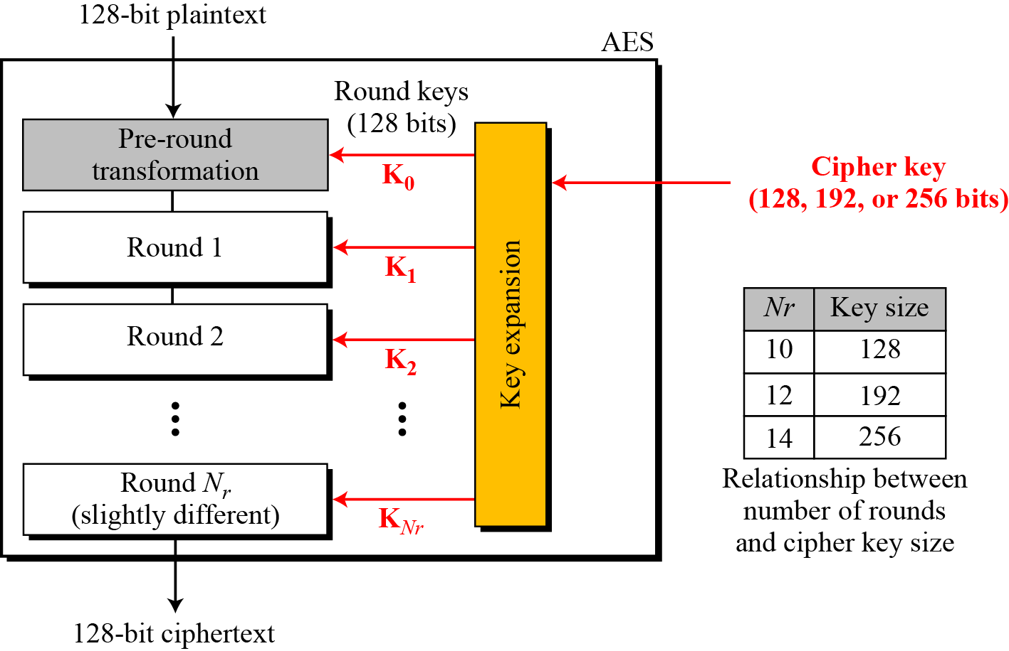
General design of AES encryption cipher

Slide 6
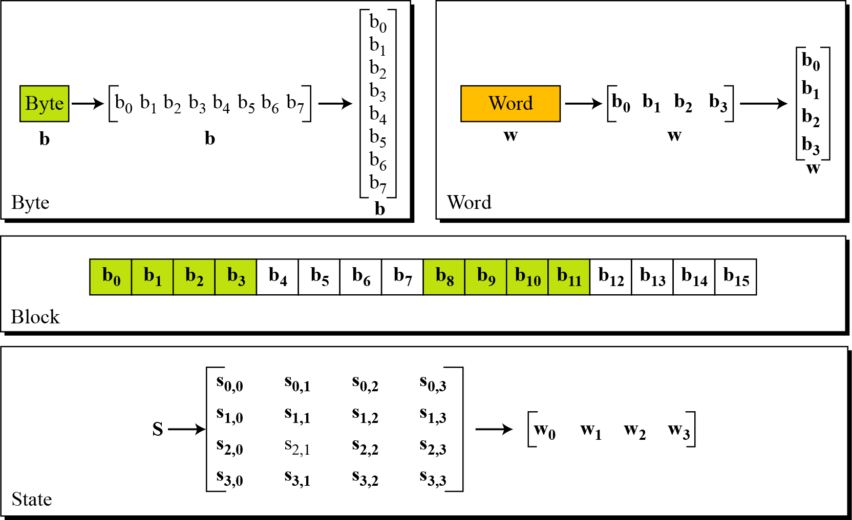
Continued….

Slide 7
History
In February 2001, NIST announced that a draft of the Federal Information Processing Standard (FIPS) was available for public review and comment. Finally, AES was published as FIPS 197 in the Federal Register in December 2001.

Slide 8
Criteria
The criteria defined by NIST for selecting AES fall into three areas:
1. Security
2. Cost
3. Implementation.

Slide 9
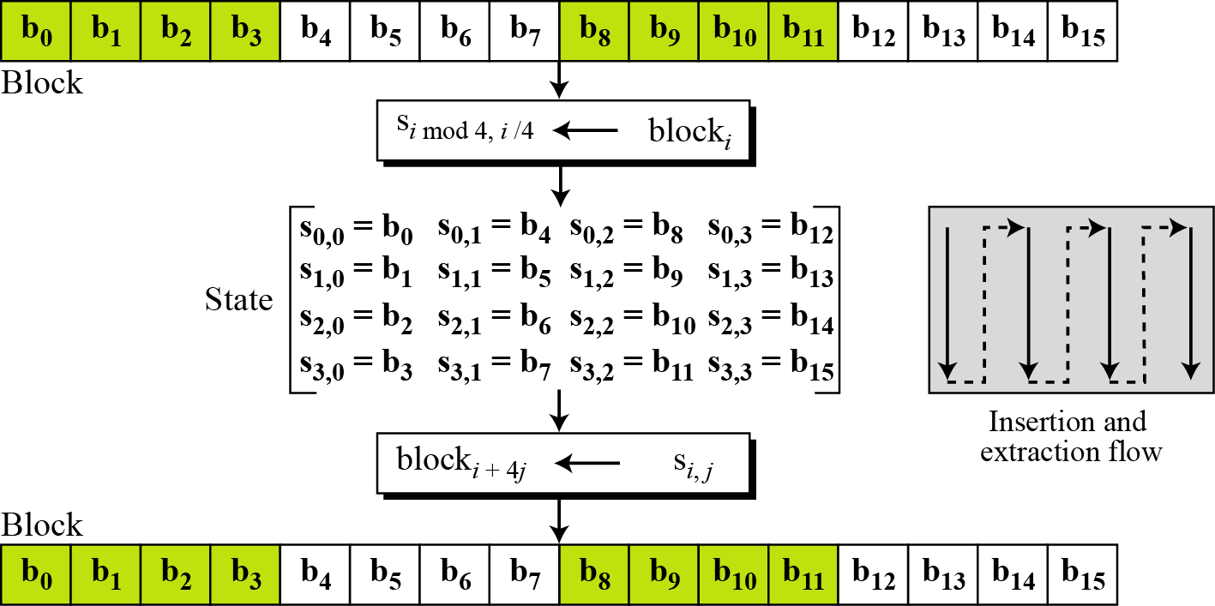

Slide 10
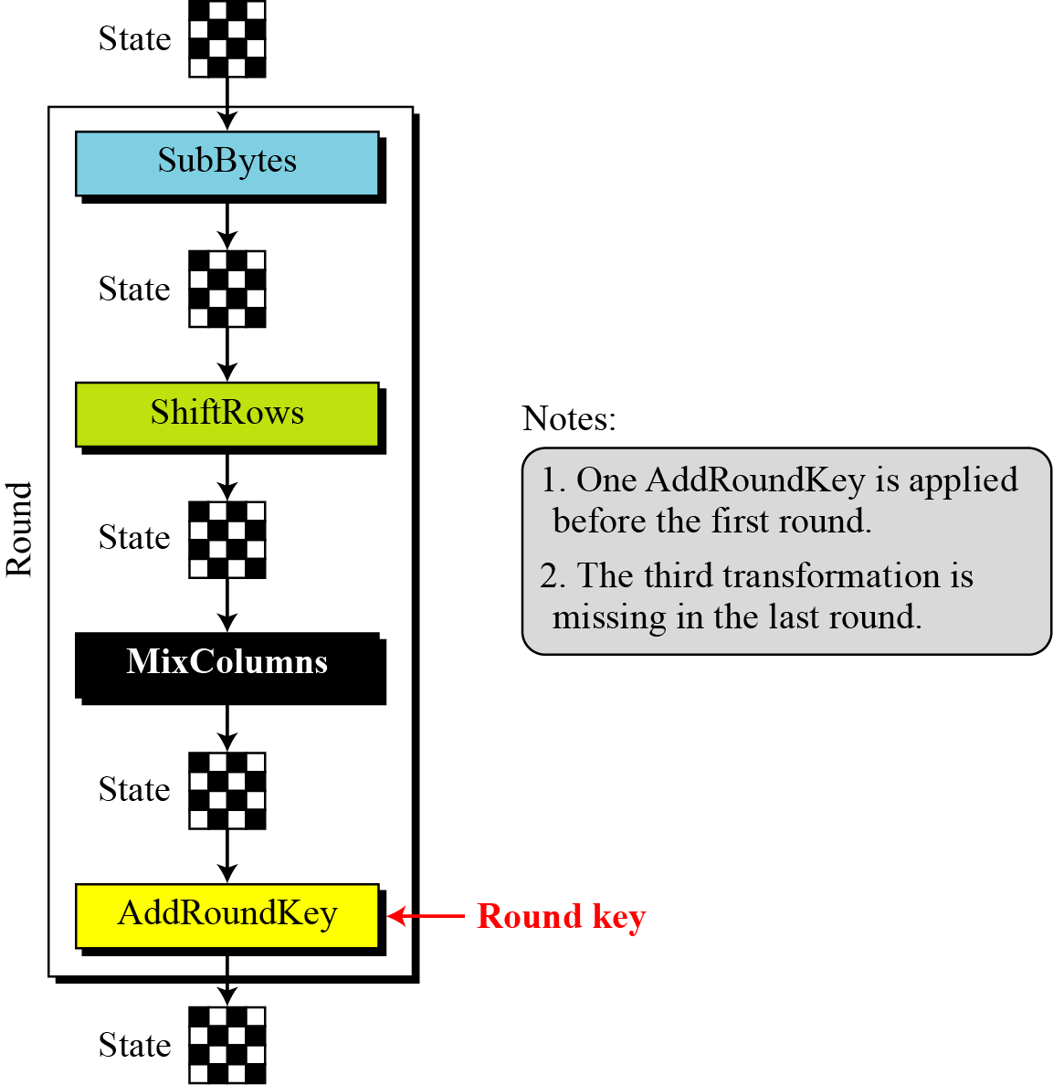
Structure of Each Round

Slide 11
Structure of each round at the encryption site

Slide 12
Substitution
AES, like DES, uses substitution. AES uses two invertible transformations.
SubBytes
The first transformation, SubBytes, is used at the encryption site. To substitute a byte, we interpret the byte as two hexadecimal digits.

Slide 13
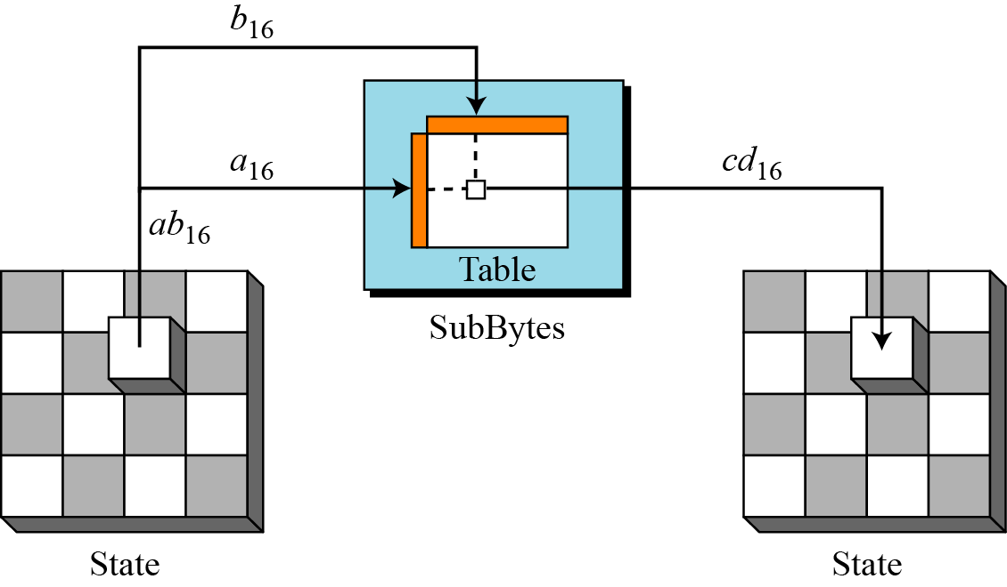
SUBBYTES

Slide 15
SECURITY IMMUNE AES
AES was designed after DES. Most of the known attacks on DES were already tested on AES.
Brute-Force Attack
AES is definitely more secure than DES due to the larger-size key.
Statistical Attacks
Numerous tests have failed to do statistical analysis of the ciphertext

Slide 16
COST
The algorithms used in AES are so simple that they can be easily implemented using cheap processors and a minimum amount of memory.

Slide 17
References
W. Mao, “Modern Cryptography – Theory and Practice”, Pearson Education
Charles P. Pfleeger, Shari Lawrence Pfleeger – “Security in computing” Third Edition – Prentice Hall of India.
“Cryptography and Network Security” by William Stallings.
Wade Trappe, Lawrence C Washington, “ Introduction to Cryptography with coding theory”, 2nd ed, Pearson, 2007.

